Slide 1
Computer Vision
Lecture # 2: Filtering
Dr. Shahid Ismail

Slide 2
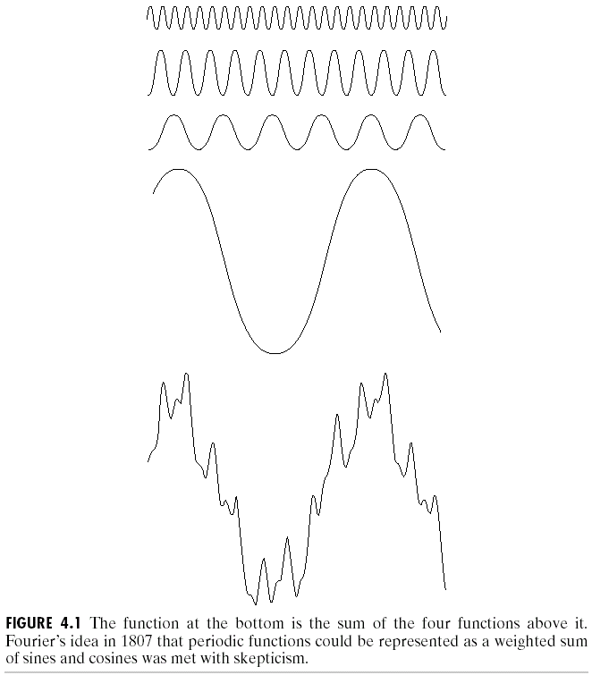
Background
The French mathematiian Jean Baptiste Joseph Fourier
Born in 1768
Published Fourier series in 1822
Fourier’s ideas were met with skepticism
Fourier series
Any periodical function can be expressed as the sum of sines and/or cosines of different frequencies, each multiplied by a different coefficient

Slide 3
Introduction to the Fourier Transform and the Frequency Domain
The one-dimensional Fourier transform and its inverse
Fourier transform
Inverse Fourier transform

Slide 4
Introduction to the Fourier Transform and the Frequency Domain
Two variables
Fourier transform
Inverse Fourier transform

Slide 5
Introduction to the Fourier Transform and the Frequency Domain
Discrete Fourier transform (DFT)
Original variable
Transformed variable

Slide 6
Introduction to the Fourier Transform and the Frequency Domain

Slide 7
Introduction to the Fourier Transform and the Frequency Domain
Basics of filtering in the frequency domain
1. Multiply the input image by to center the transform
2. Compute F(u,v)
3. Multiply F(u,v) by a filter function H(u,v)
4. Compute the inverse DFT
5. Obtain the real part
6. Multiply the result by

Slide 8
Introduction to the Fourier Transform and the Frequency Domain
Fourier transform of the output image
zero-phase-shift filter
Real H(u,v)

Slide 9
Introduction to the Fourier Transform and the Frequency Domain
Inverse Fourier transform of G(u,v)
The imaginary components of the inverse transform should all be zero
When the input image and the filter function are real

Slide 10
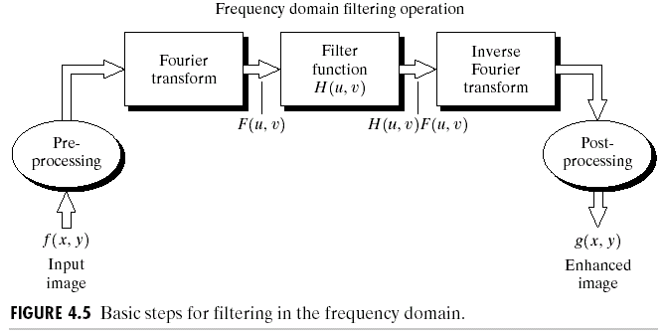
Introduction to the Fourier Transform and the Frequency Domain

Slide 11
Introduction to the Fourier Transform and the Frequency Domain
Lowpass filter
Pass low frequencies, attenuate high frequencies
Blurring
Highpass filter
Pass high frequencies, attenuate low frequencies
Edges, noise

Slide 12
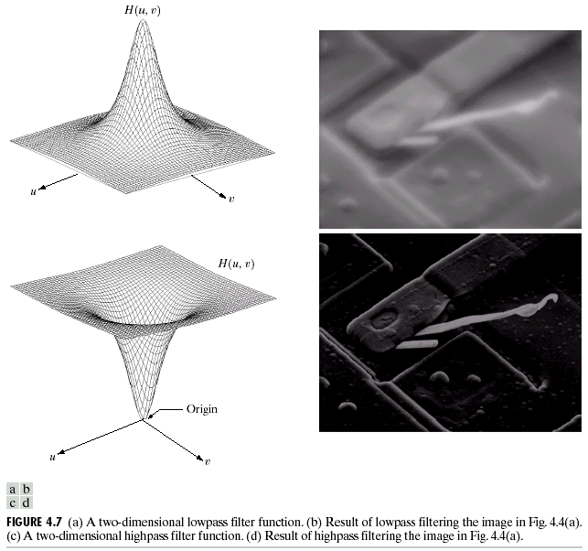

Slide 13
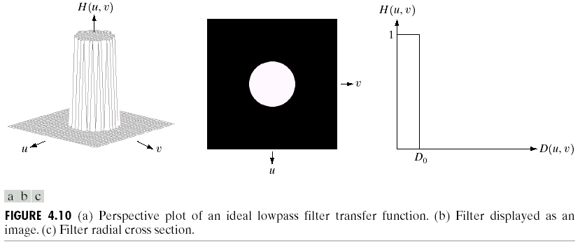
Smoothing Frequency-Domain Filterers
Ideal lowpass filters

Slide 14
Power
Cutoff frequency
Total image power
Portion of the total power

Slide 15
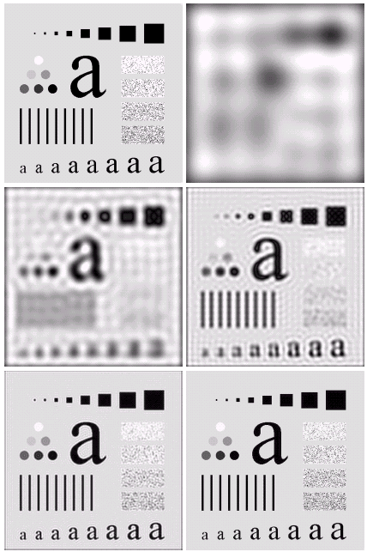
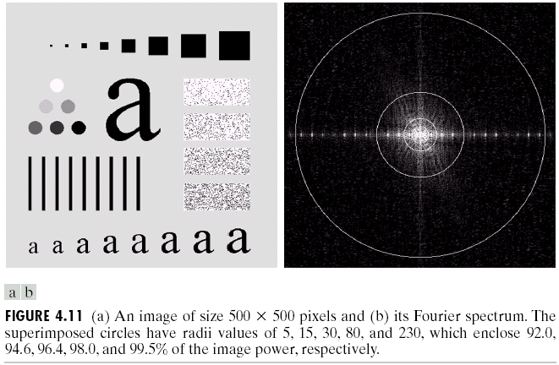

Smoothing Frequency-Domain Filterers

Slide 16
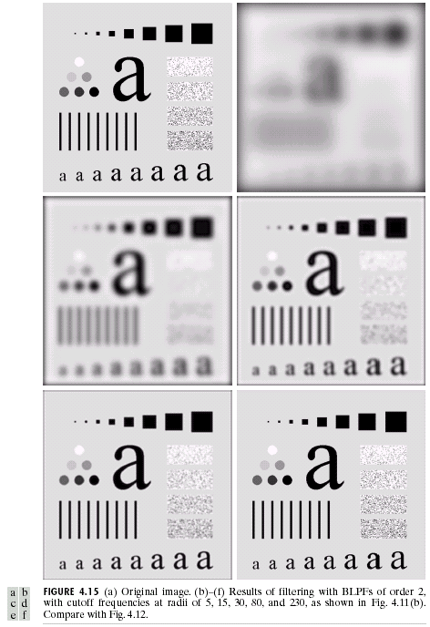
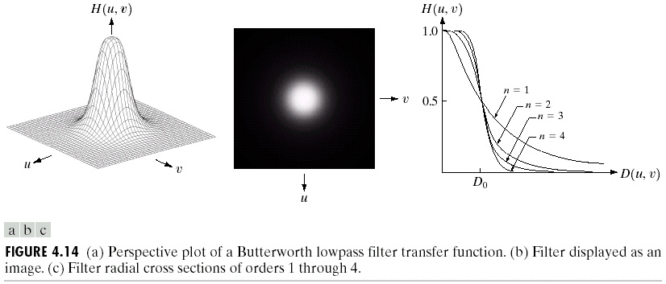
Butterworth lowpass filters

Slide 17
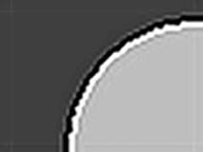
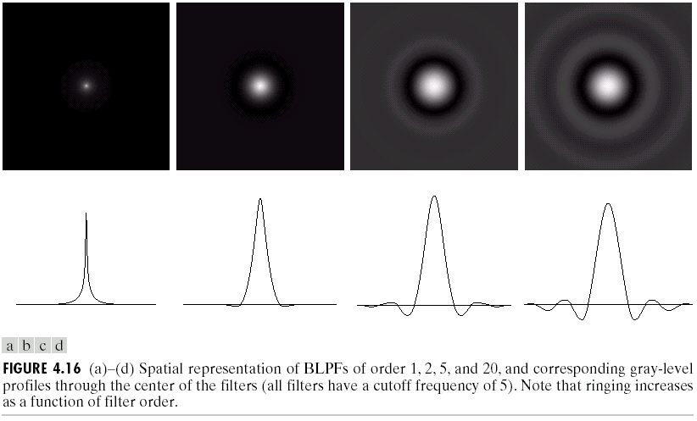
Butterworth lowpass filters
Butterworth lowpass filters
Order 1: No ringing
Order 2: Imperceptible ringing
Higher order: Ringing becomes a significant factor
The main cause of ringing artifacts is overshoot and oscillations in the step response of a filter. The main cause of ringing artifacts is due to a signal being bandlimited

Slide 18
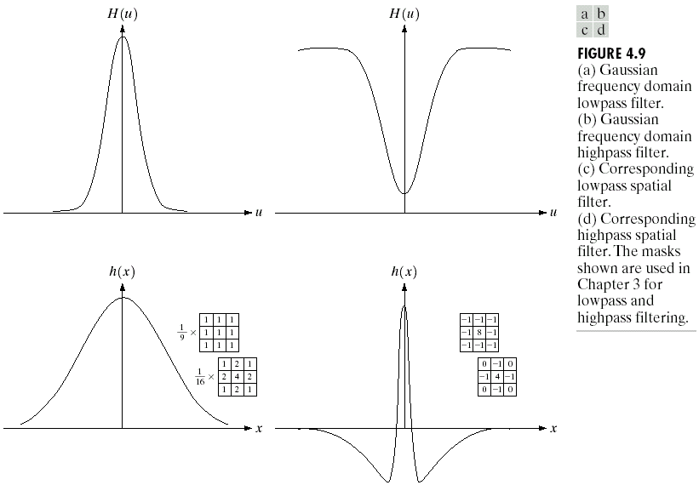
Gaussian filter

Slide 19
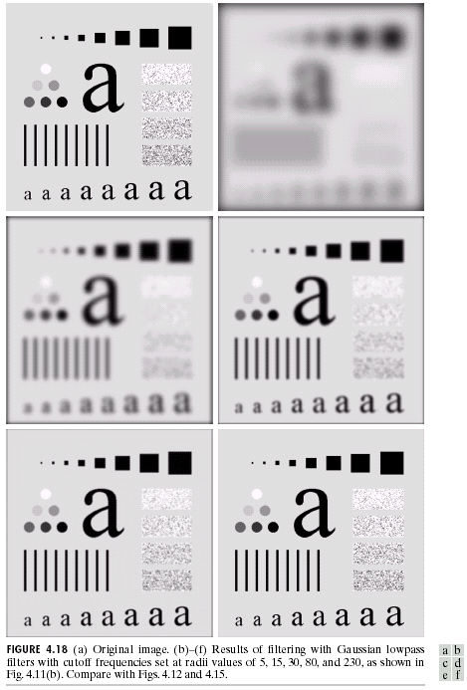
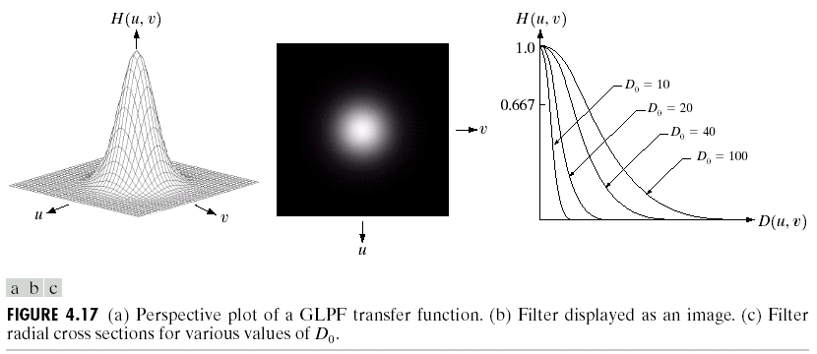
Gaussian filter

Slide 20
Homomorphic Filtering
Illumination and reflectance components
Derivations
Decrease the contribution made by the low frequencies (illumination)
Amplify the contribution made by high frequencies (reflectance)
Simultaneous dynamic range compression and contrast enhancement

Slide 21
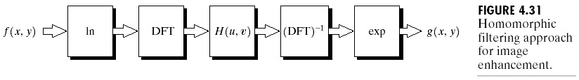
Homomorphic Filtering
Frequency domain
Spatial domain

Slide 22
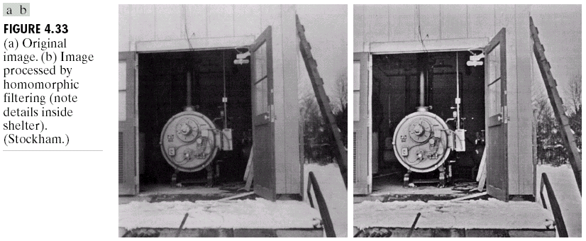
Homomorphic Filtering

